Slide 1
What is Function?
By: Iman Khani Jazani
Senior Data Scientist, Community builder | Adin
AI and Data Specialist, Business Developer | AiHum
Adjunct Professor | Sharif University of Technology

Slide 2
Last lecture
Short Presentation
Review the Last Lecture
Coding a simple example
Programming with Python
Application of Programming in the Digital Age!

Slide 3
Today
Short Presentation
Review the Last Lecture
Different scops in Python
Programming with Python
Application of Programming in the Digital Age!

Slide 4
Together
Send your feedback about the class whenever you want!

Slide 5
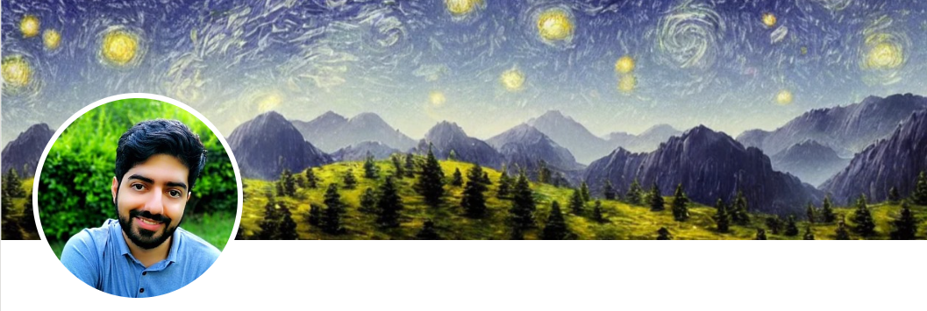
Contact me
Gmail: ImanKhaniJazani@gmail.com
LinkedIn: https://www.linkedin.com/in/ImanKhaniJazani/
Telegram: @IKJ1992

Slide 6
Grading
راه جبران هم تحت شرایطی وجود داره!
Approx. 25% Programming Assignments (judgment with Quera)
Approx. 14% Mid-term Project (alone, judgment with TAs and Quera)
Approx. 37% Final Project (team work~5 member, judgment with TAs and Quera)
Proposal (about real needs)
Coding
Release
Approx. 30% Final Exam (algorithm-based paper exam)
Approx. 5% Short Presentation(extra score , for the next week lecture, only for the first two person)
Approx. 2% Challenging Questions and Contributions in Class or Telegram group (extra score)
Approx. 7% long presentation (extra score)
Approx. ?% Quiz
Notes:
120 score

Slide 7
Short Presentations

Slide 8
Review the Last Lecture

Slide 9
From question to algorithm!
Understand your needs or questions!
explain easily for someone else
Decompose your problem (make some steps)!
Make a flowchart for the decomposed version of your problem
Explain each steps in one or two sentences (paper-based or paperless)
input, output, process
Explain each steps mathematically…
Develop your algorithms for each steps
Check your process flow from the first step to the last one!

Slide 10
Question
What is the website need?
How can we get more users for our news website?
Our solution: find most frequent words in news
آیا کارمون اخلاقی بود؟!؟

Slide 11
Ask your Questions, even SIMPLE ones!
Ask question
Think about answer
Ask question
Read more about it through internet
Ask question
Read another pages or listen to others’ explanation
Ask question
…

Slide 12
Ask your Question 😉
این درس برای پیشرفت شماست...

Slide 13
مسئله ترافیک و پمپ بزنین رو فکر کردی بهش؟

Slide 14
Different Scops in Python

Slide 15
I want to run our power.py for different inputs
What is your solution?

Slide 16

Functions
Function name (process)
$$y=F(x)$$
output
input

Slide 17
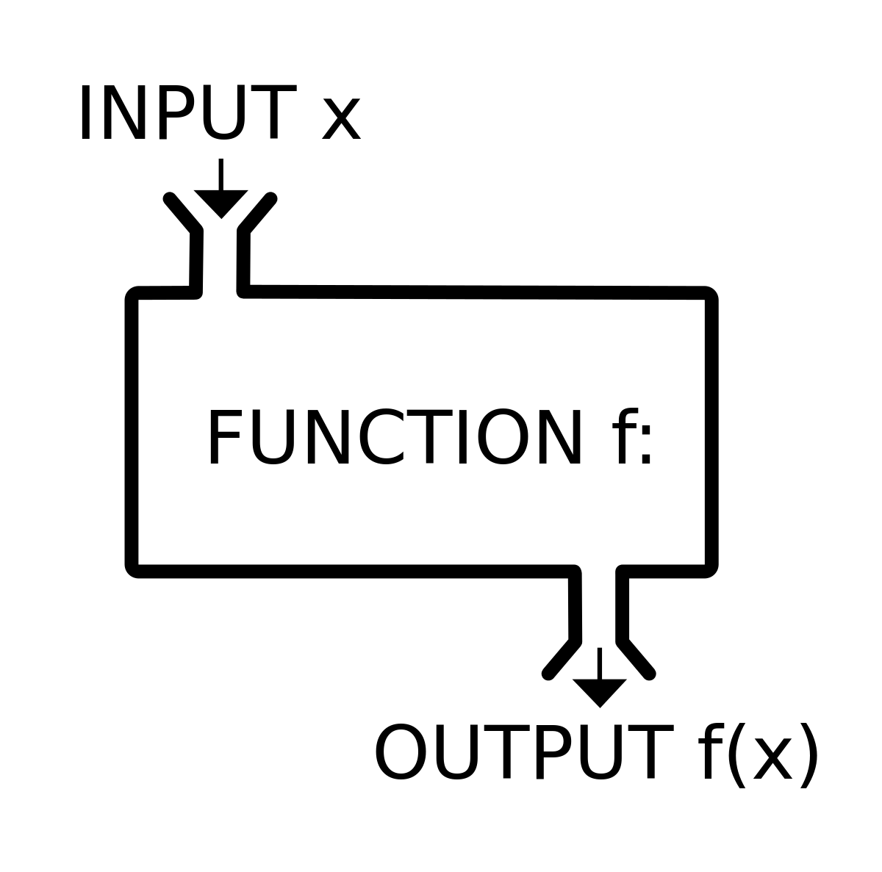
Functions

Slide 18
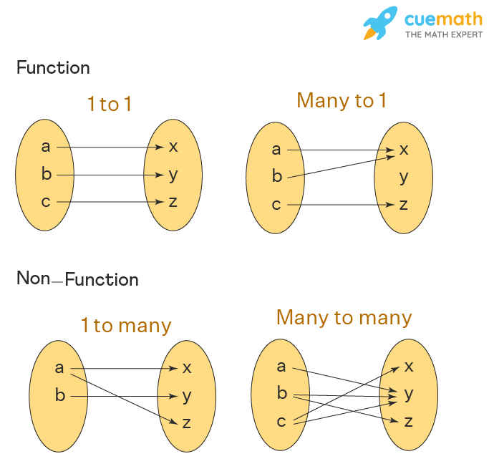
Functions

Slide 19
Functions
Input 1
Input 2
Input 3
Output 1 , Output 2, …

Slide 20
Modules

Slide 21
Packages

Slide 22
SuperPackages

Slide 23
Programming with Python

Slide 24
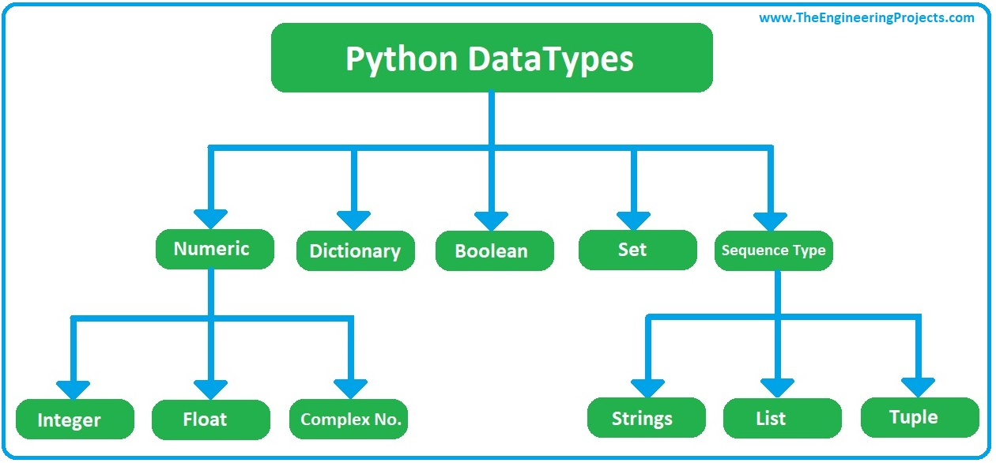
Python DataTypes

Slide 25
List methods | what is methods?!?!

Slide 26
Question
What is the website need?
How can we get more users for our news website?
Our solution: find most frequent words in news
علایق کاربرها مهم هستند!

Slide 27
Example of news
https://www.theguardian.com/uk-news/2023/mar/05/rishi-sunaks-plan-for-small-boats-will-lock-up-people-fleeing-war

Slide 28
From question to algorithm!
Understand your needs or questions!
explain easily for someone else
Decompose your problem (make some steps)!
Make a flowchart for the decomposed version of your problem
Explain each steps in one or two sentences (paper-based or paperless)
input, output, process
Explain each steps mathematically…
Develop your algorithms for each steps
Check your process flow from the first step to the last one!

Slide 29

Let’s go for your solutions and coding with each other😉
Input?
Output?
Process?

Slide 30
Application of Programming in the Digital Age!

Slide 31
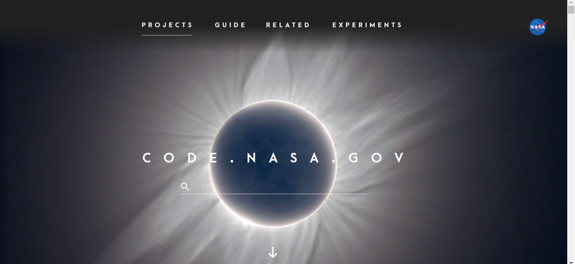
code.NASA.gov

Slide 32
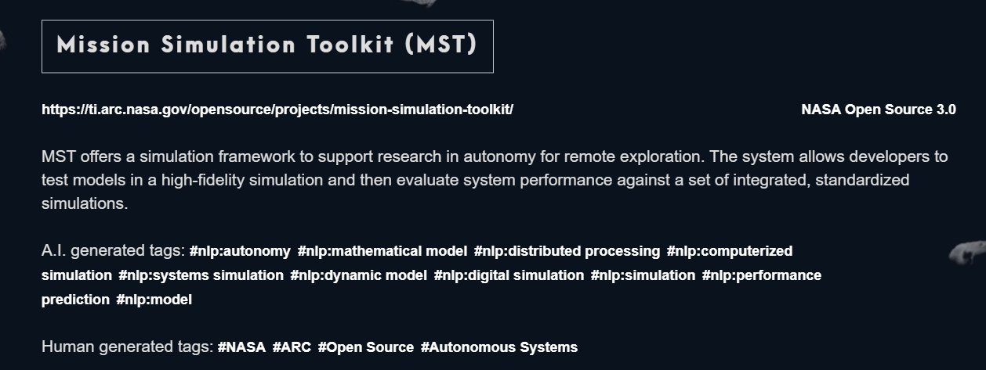
Project 1

Slide 33
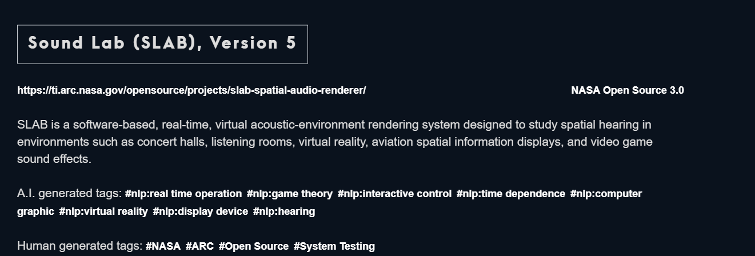
Project 2

Slide 34
Lecture Resources

